Slide 1

Algorithms and Data Structures 1 CS 0445
Fall 2023
Iterators
Sherif Khattab
ksm73@pitt.edu
(Slides adapted from slides of Textbook and Dr. Ramirez’s CS 0445)

Slide 2
Announcements
Upcoming Deadlines:
Lab 6: Friday 12/1 @ 11:59 pm
Homework 11: Tuesday 12/5 @ 11:59 pm
Assignment 5: Friday 12/8 @ 11:59 pm
Support Slides and Support session in recitations this week
Bonus assignment point for attending support session

Slide 3
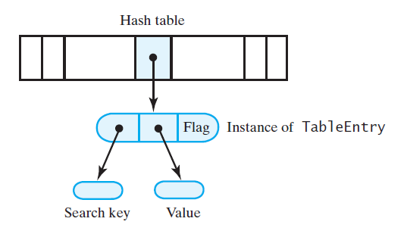
Linear Probing Implementation

Slide 4
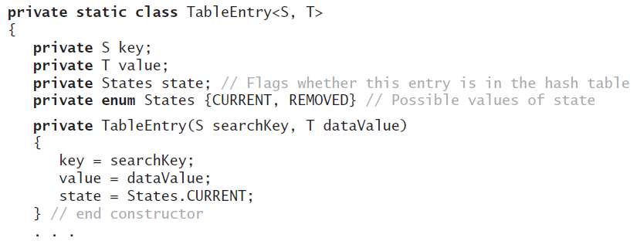
TableEntry

Slide 5
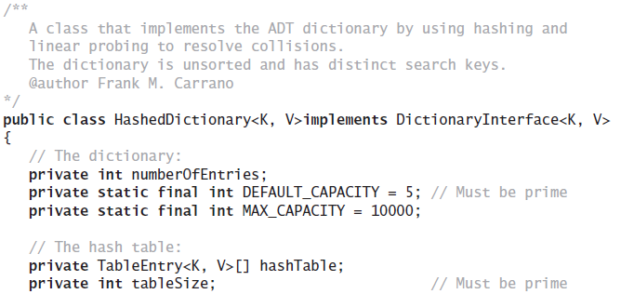
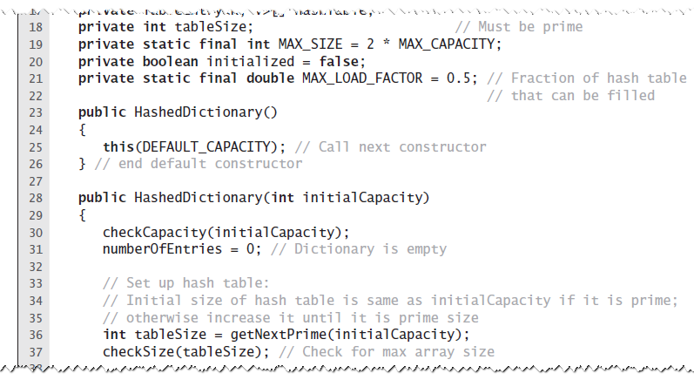
Data Fields of HashedDictionary

Slide 6
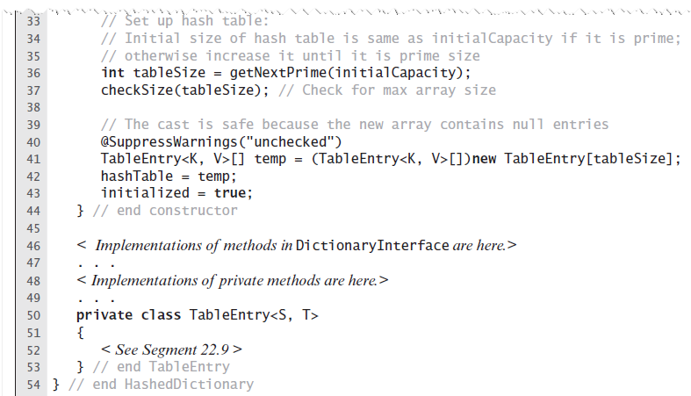
Constructors

Slide 7
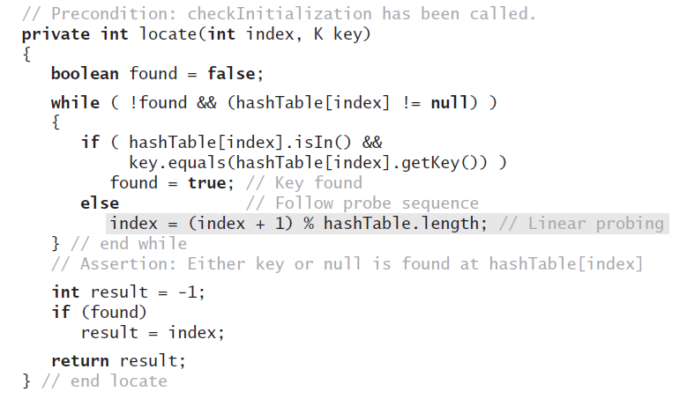
locate

Slide 8
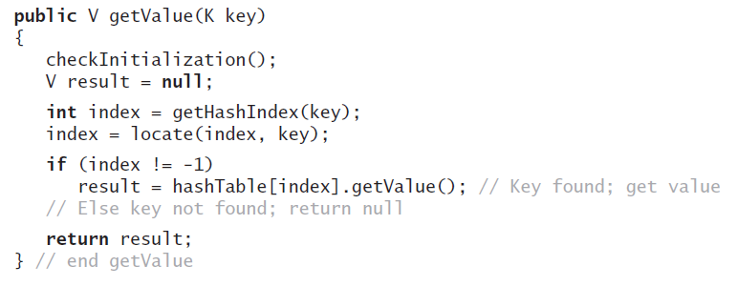
getValue

Slide 9
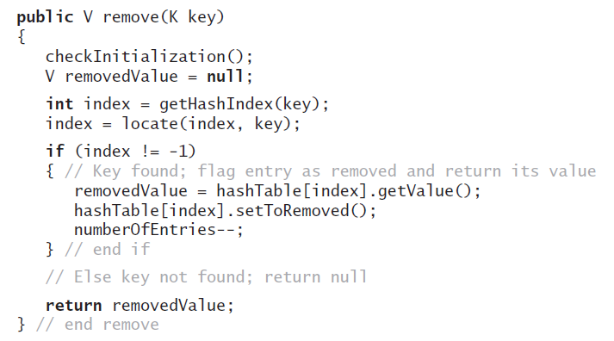
remove

Slide 10
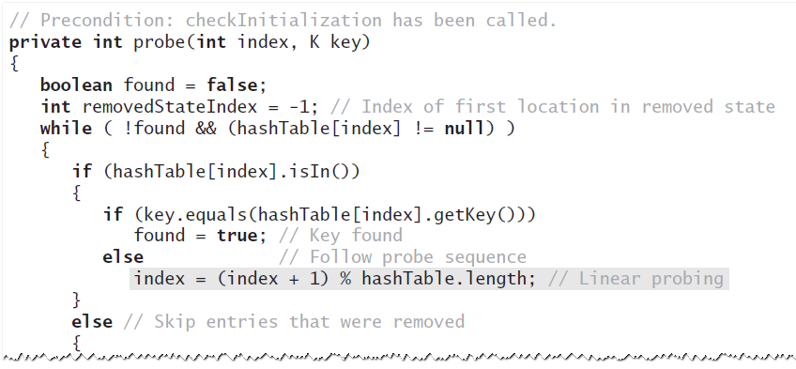
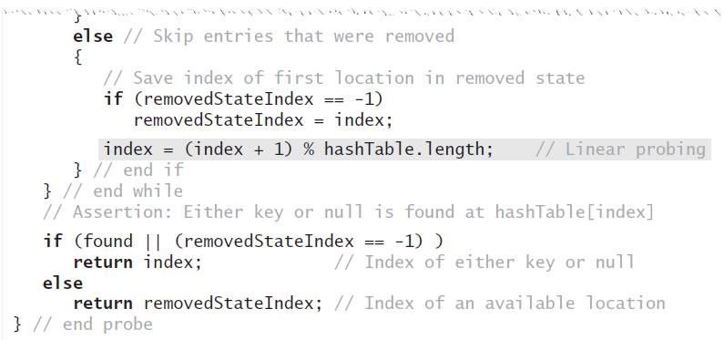
probe

Slide 11
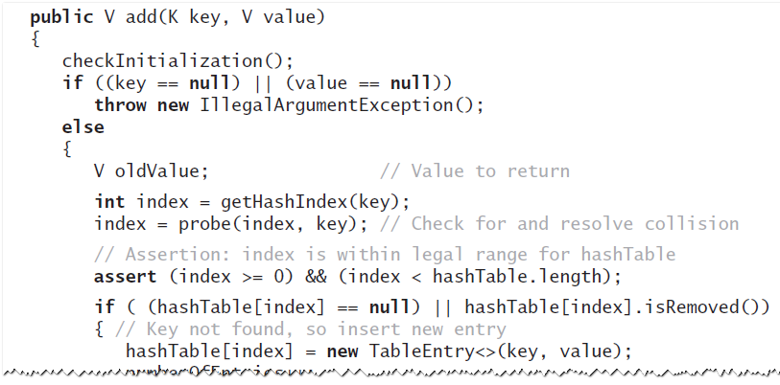
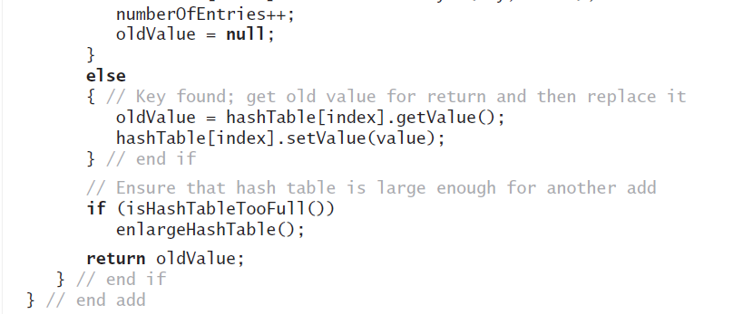
add

Slide 12
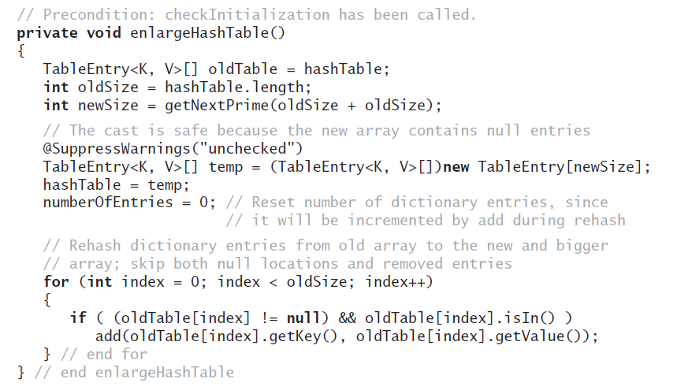
Resize Hash Table

Slide 13
Java Class Library: HashMap
Hash table is a collection of buckets
Each bucket contains several entries
Default maximum load factor is 0.75
When limit exceeded, size of table increased by rehashing
Possible to avoid rehashing by setting number of buckets initially larger

Slide 14
Java Class Library: HashSet
Implements the interface java.util.Set
HashSet uses a HashMap object

Slide 15
How to traverse a collection?
Define ADT operations
Implement traversal methods within their own class

Slide 16
What Is an Iterator?
An object that traverses a collection of data
During iteration, each data item is considered once
Possible to modify item as accessed
Analogy: Text cursor in a text document

Slide 17
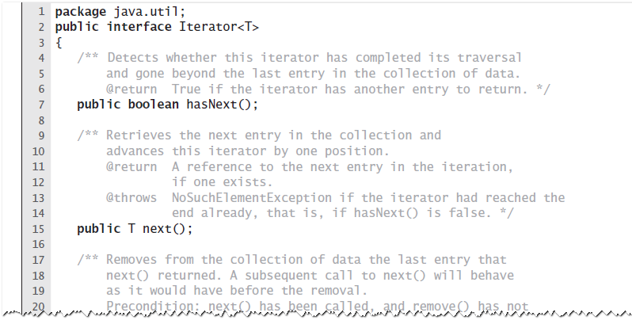
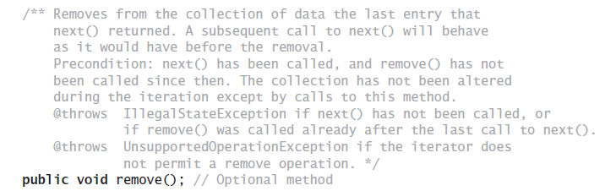
The Interface Iterator

Slide 18
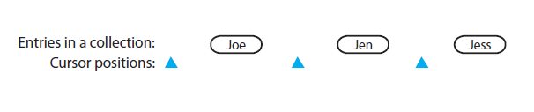
The Interface Iterator
Possible positions of an iterator’s cursor

Slide 19
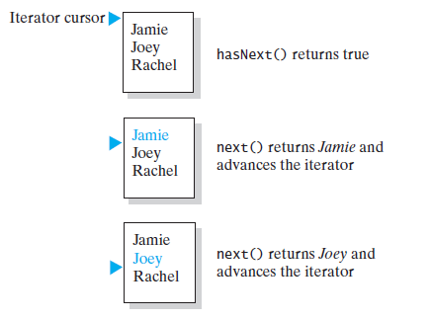
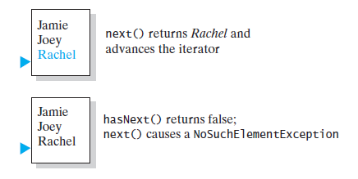
hasNext and next

Slide 20
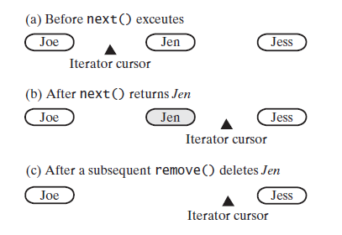
next followed by remove

Slide 21
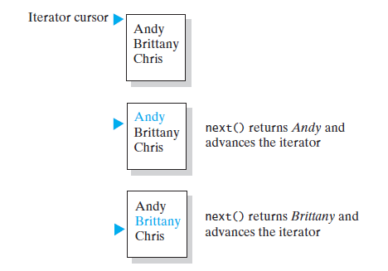
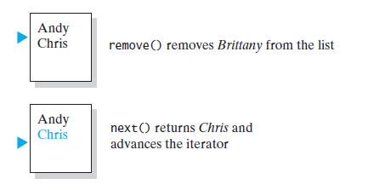
next followed by remove

Slide 22
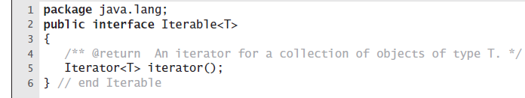
How to get an Iterator object?

Slide 23
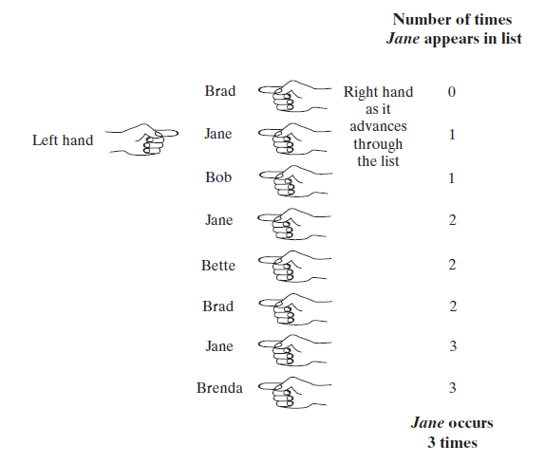
Multiple Iterators
count the occurrences of each name in a List

Slide 24
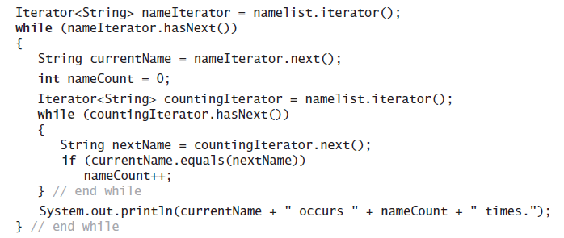
Multiple Iterators
counts the occurrences of each name in a List

Slide 25
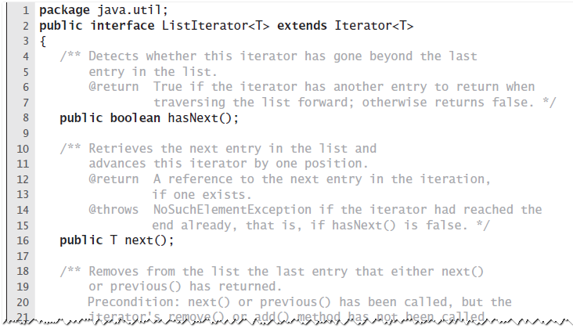
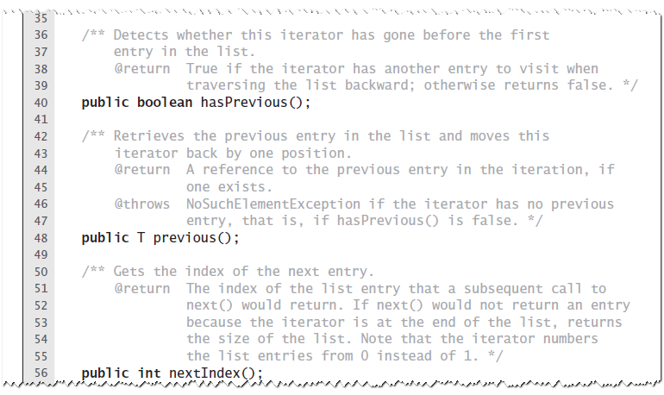
The Interface ListIterator

Slide 26
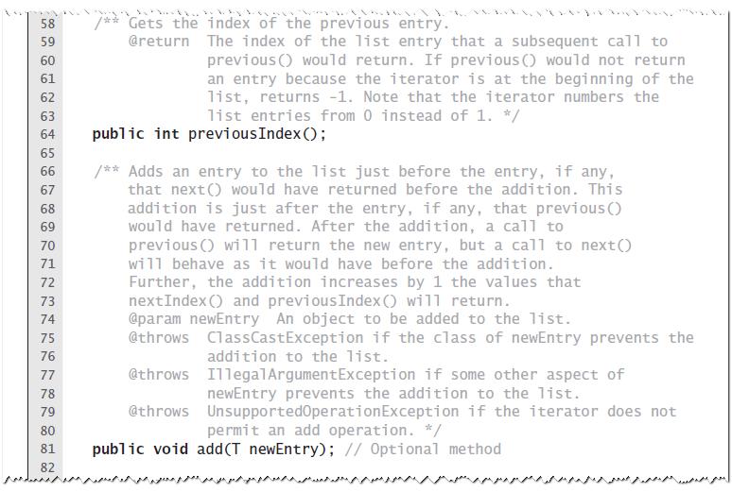
The Interface ListIterator

Slide 27
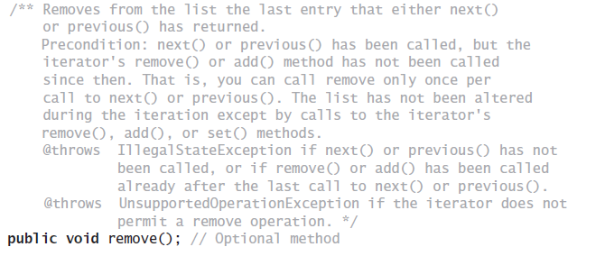
The Interface ListIterator

Slide 28
The Interface ListIterator

Slide 29
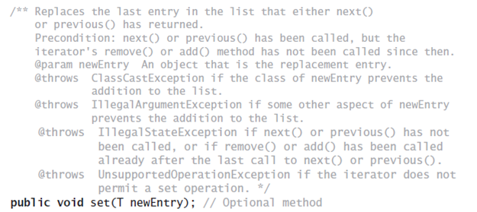
The Interface ListIterator

Slide 30
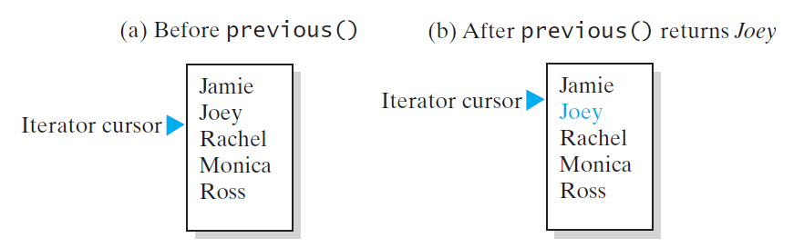
previous

Slide 31
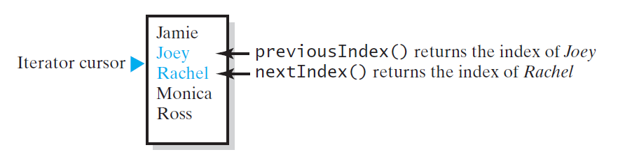
nextIndex and previousIndex

Slide 32
set, remove, and add
set replaces what next or previous just returned.
add inserts just before iterator’s current position
remove removes what next or previous returned

Slide 33
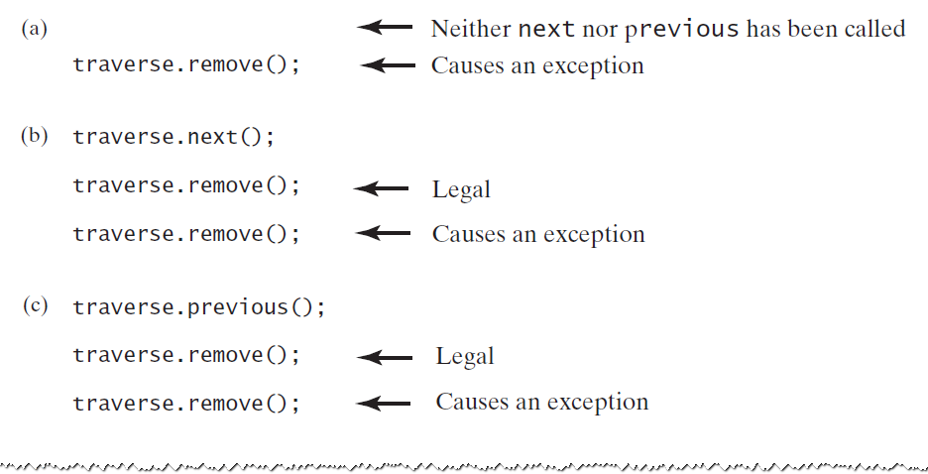
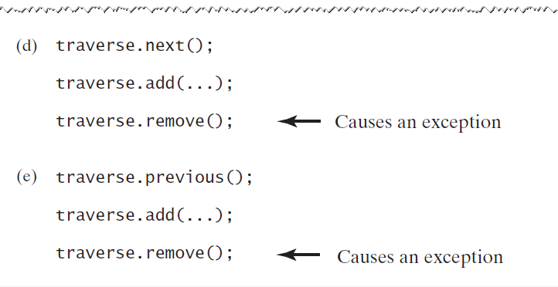
remove

